Slide 1
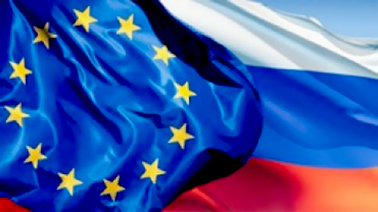
Economic Modernization in Russia: Opportunities of the EU-Russian partnership in Energy Efficiency
By: Jeroen Ketting
Managing Director, Lighthouse Russia BV

Slide 2
Benefits of EU-Russian Partnership
Import of technologies, equipment, materials.
Transfer of expertise and knowledge.
Venture investments into Russian SMEs.
De-monopolization and sophistication of Russian markets through increased competition.
This will also lead to increased energy efficiency of the Russian economy.
And thus to the Economic Modernization in Russia!

Slide 3
Investment into Energy Efficiency in Russia
The Russian Ministry of Energy estimates that until 2020 $80 bn. need to be invested into energy efficiency and $300 bn. in renewable energy:
to reduce energy intensity of the Russian economy by 40%;
to reduce energy consumption by 45%.
The EE investments in Russia are still very low, compared to worldwide figures:
Investments into energy efficiency and renewable energy in Russia in 2010 equaled $2 bn.
Worldwide investments into energy efficiency in 2009 equaled $30 bn. and $243 bn. were invested into renewable energy.
The German market of energy efficient technologies was worth 67 bn. Euro in 2010 and 25 bn. Euro were invested in renewable energy in 2010.

Slide 4
Business opportunities in EE on the Russian market
Innovative products or technologies, which are:
Simple
Proven
Replicable
For a closed and controlled environment
Applicable to a mass market
Products that can be used in and around the built environment: insulation materials, energy efficient heating and cooling systems, lighting, intelligent control systems, smart meters and energy efficient appliances.
Technologies that can essentially be used in any industry: pumps, electric motors, compressed air systems and measurement and control systems are of interest.
Consulting services: advice on energy-efficient methods and production processes.

Slide 5
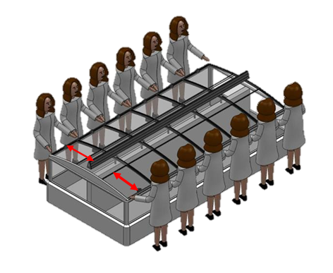
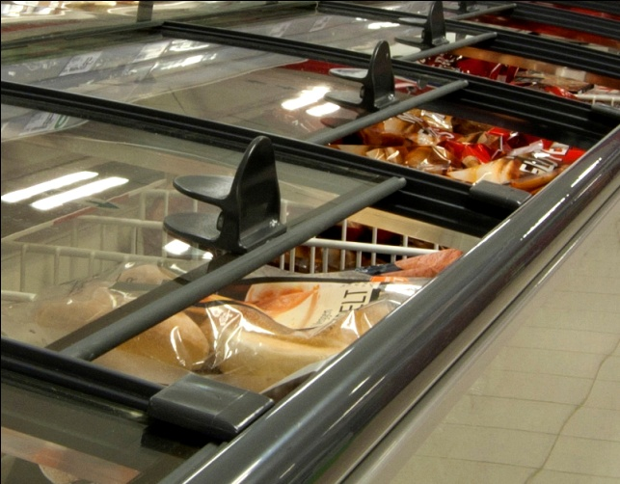
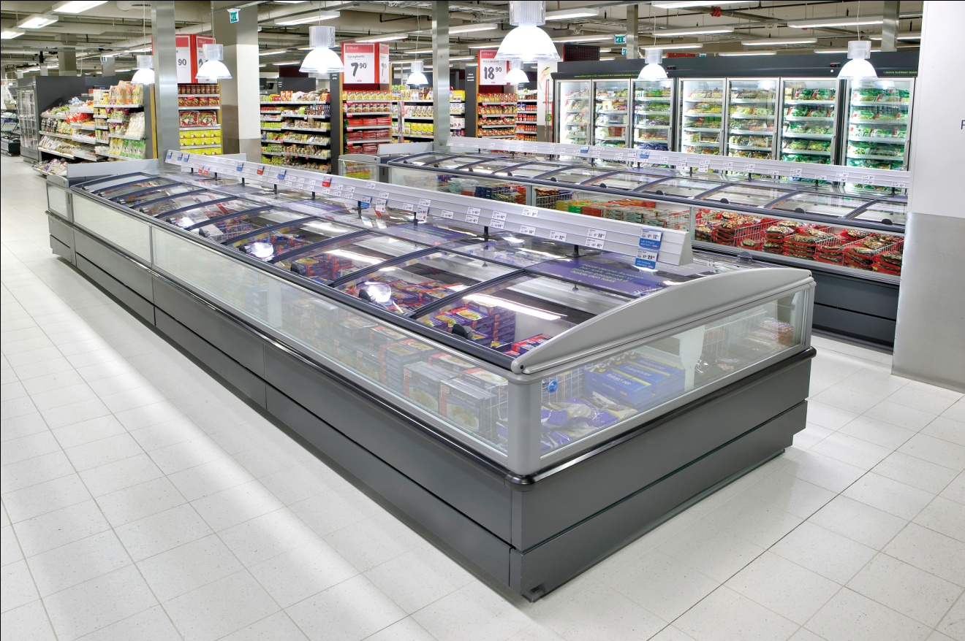
Energy efficient solutions in the retail sector:
Behr A/S (Denmark) glass covers for freezer islands
SUPERMARKET
Reduction of energy consumption by 50%;
Reduction of CO2 emissions by 30%;
Longer lifecycle of equipment;
Improved hygienic conditions and temperature safety;
Increased sales and new merchandising opportunities.
CONSUMERS
Higher quality of frozen foods;
Improved service, i.e. visibility, access;
Improved store climate.
ECONOMY
Energy cost reduction;
CO2 emissions reduction;
Energy efficient retail sector;
Upselling opportunities.

Slide 6
Potential of the Russian market
DANISH MARKET
2.804 food retail stores
Average size of order (incl. installation) = 10 000 EUR
Danish market for glass covers equals 28.000.000 EUR
Behr A/S supplied to 840 stores = 30% of the market
Total Behr A/S sales in Denmark = 8.400.000. EUR
RUSSIAN MARKET
129.713 food retail stores
Potential Russian market for glass covers (est.) equals 1.290.000.000 EUR.
Potential of Behr A/S = 388,6 mln
Potential Behr A/S clients:
Smaller market of frozen food – 50% reduction of market share
50% of the Russian freezer islands are not worth equipping (end of lifecycle)
Sales potential of Behr A/S in Russia (est.) = 97.150.000 EUR = 7,5% of the market
VS

Slide 7
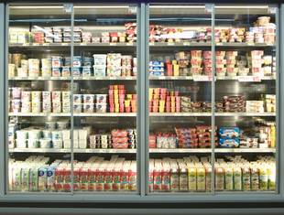
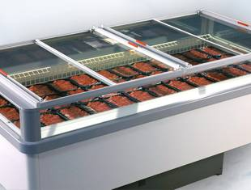
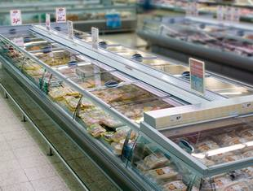
REMIS GmbH
Köln, Germany

